Slide 1
Diffusion Model

Slide 2
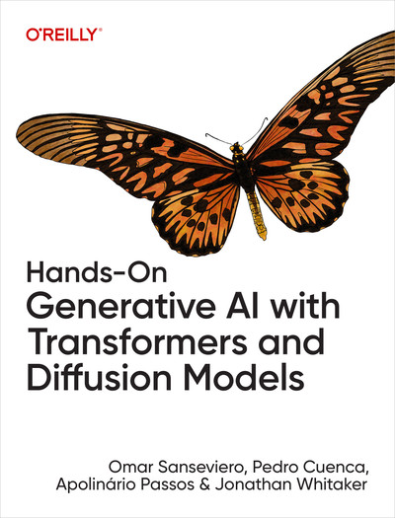
I. Leveraging Open Models
1. An Introduction to Generative Media
2. Transformers
3. Compressing and Representing Information
4. Diffusion Models
5. Stable Diffusion and Conditional Generation
II. Transfer Learning for Generative Models
6. Fine-Tuning Language Models
7. Fine-Tuning Stable Diffusion
III. Going Further
8. Creative Applications of Text-to-Image Models
9. Generating Audio
10. Rapidly Advancing Areas in Generative AI
A. Open Source Tools
B. LLM Memory Requirements
C. End-to-End Retrieval-Augmented Generation

Slide 3


Deployment Tools
vLLM

Slide 4
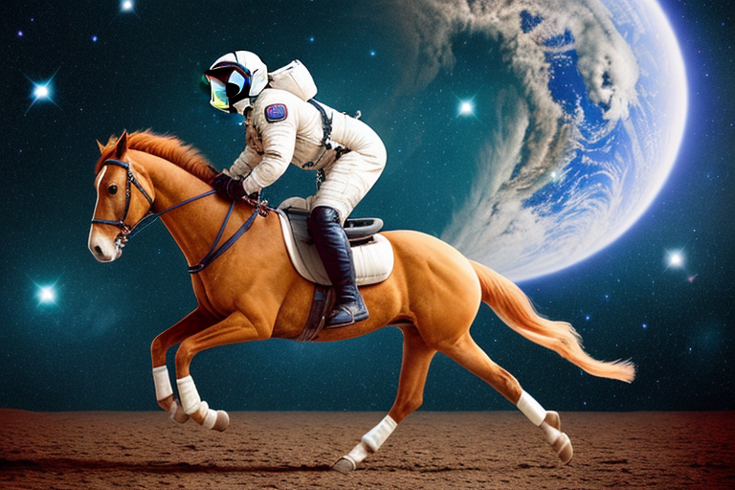

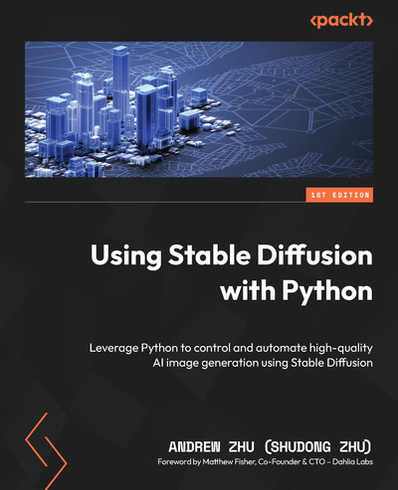
prompt =
"a photograph of an astronaut riding a horse"

Slide 5

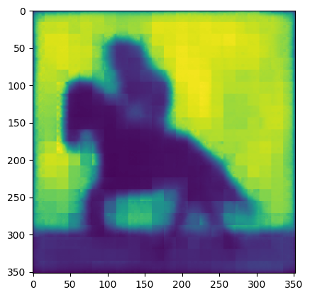

generate mask data
genearte mask binary image

Slide 6
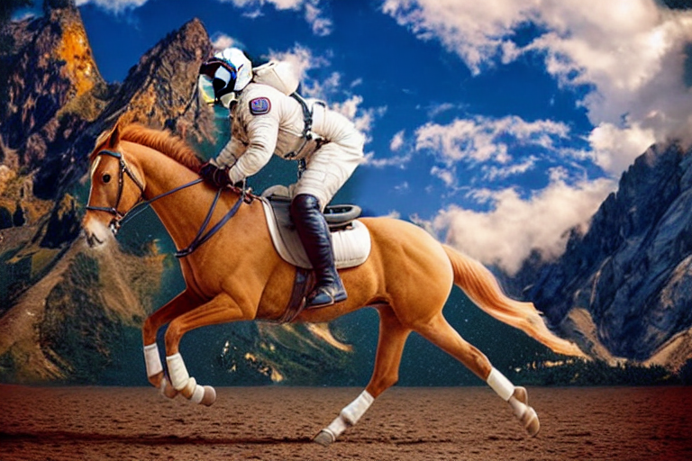

Slide 7
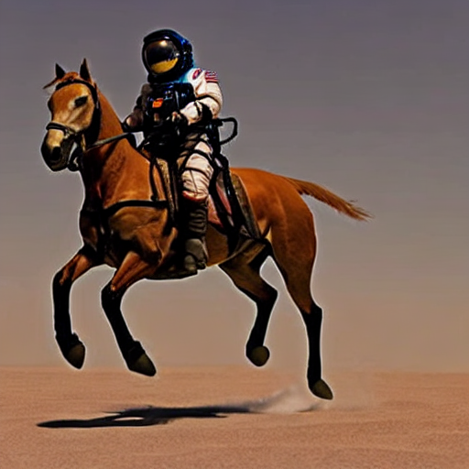
prompt =
"a photo of an astronaut riding a horse on mars,blazing fast, wind and sand moving back"

Slide 8
# install diffusers
%pip install -U diffusers
# start pipeline
import torch
from diffusers import StableDiffusionPipeline
pipe = StableDiffusionPipeline.from_pretrained(
"runwayml/stable-diffusion-v1-5"
, torch_dtype=torch.float16
).to("cuda:0")
# Generate an image
prompt = "a photo of an astronaut riding a horse on mars,blazing fast, wind and sand moving back"
image = pipe( prompt, num_inference_steps=30 ).images[0]
image

